Slide 1
IP Subnetting – Zero to Hero Why do we need subnetting?
CyberQuince

Slide 2
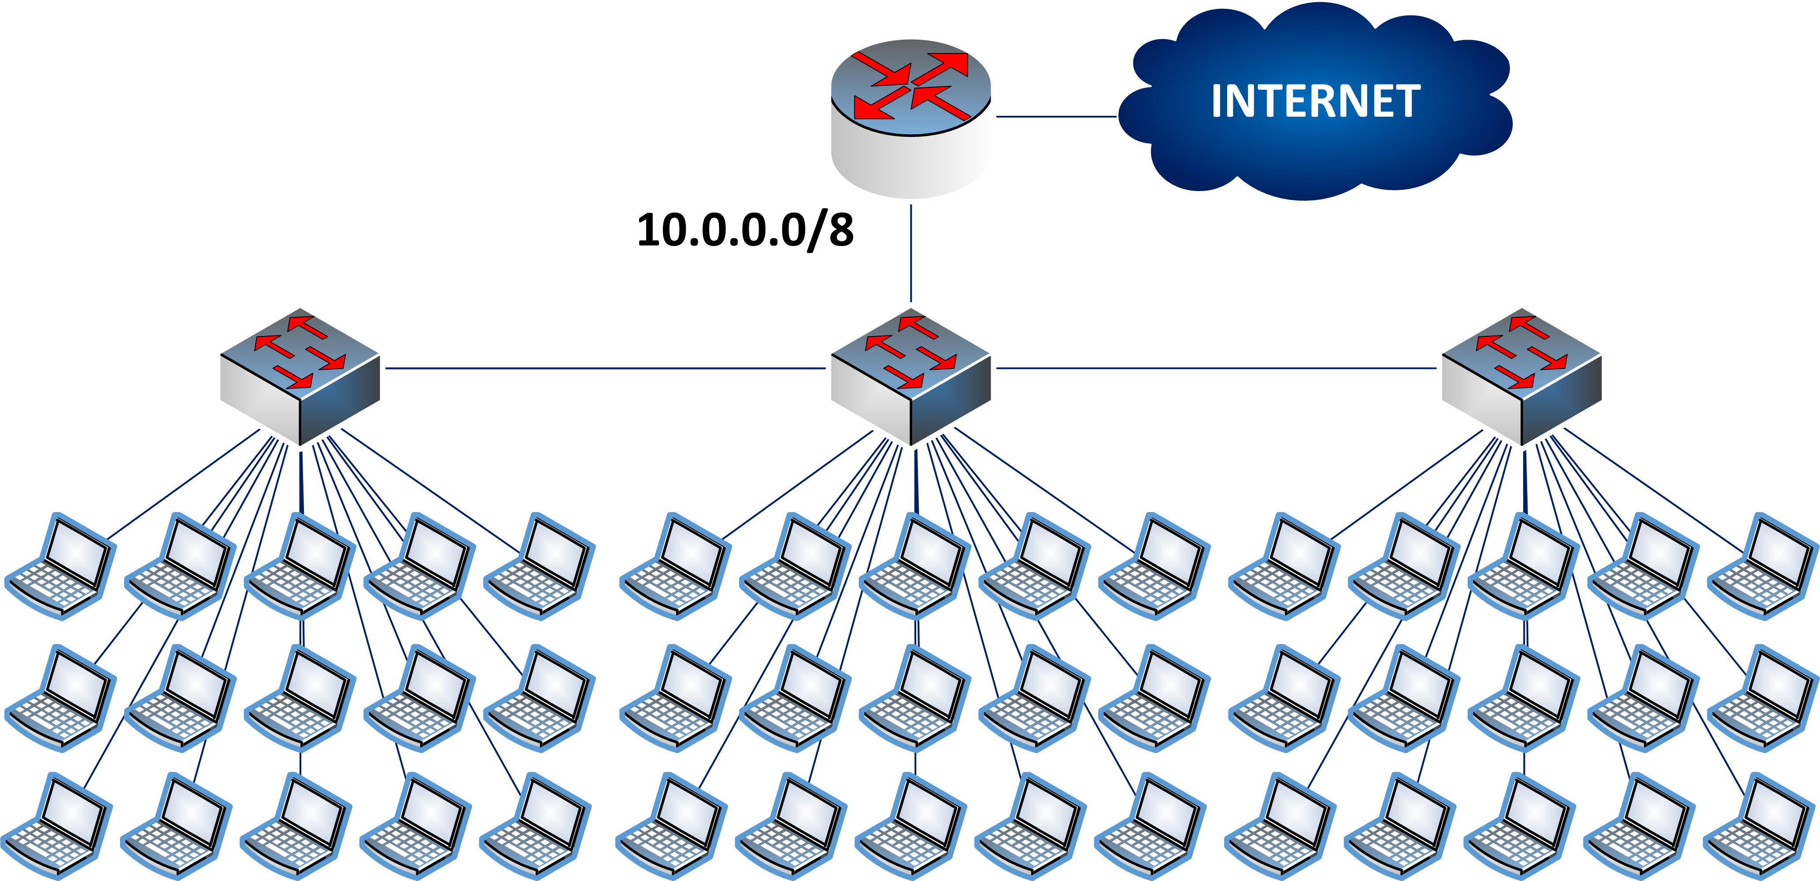
A World Without Subnets

Slide 3

A World Without Subnets

Slide 4

A World Without Subnets

Slide 5

A World Without Subnets

Slide 6

A World Without Subnets

Slide 7
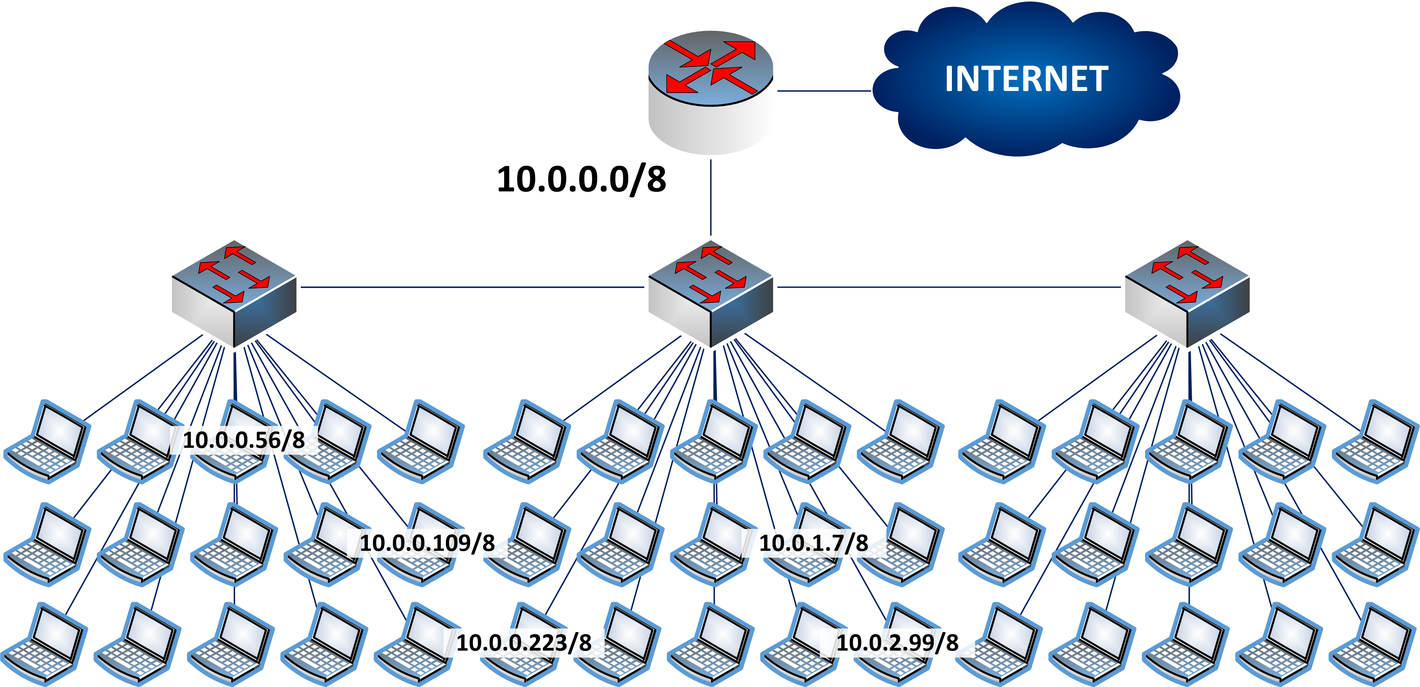
A World Without Subnets

Slide 8
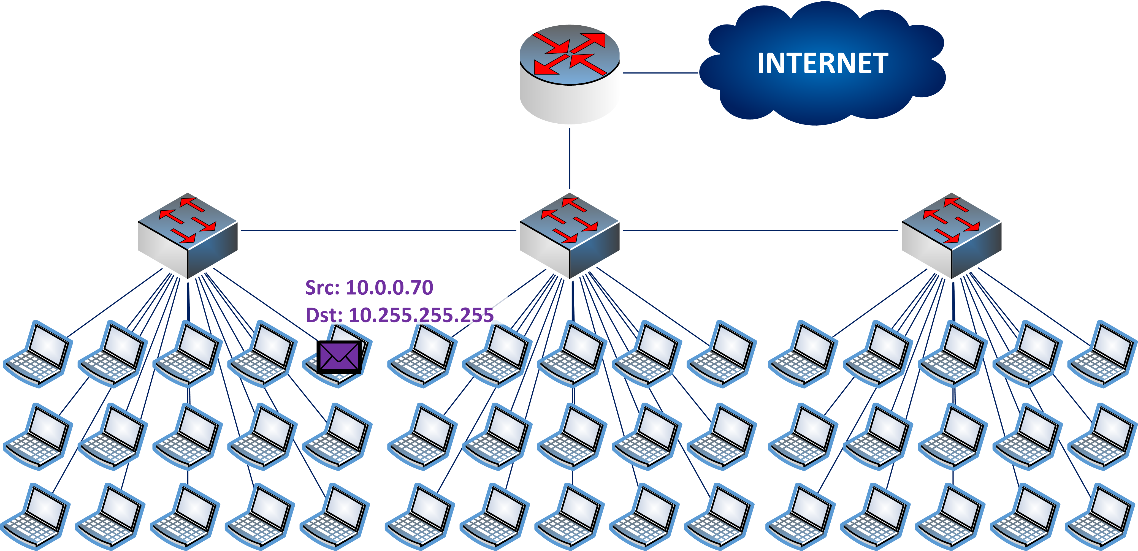
Broadcast

Slide 9
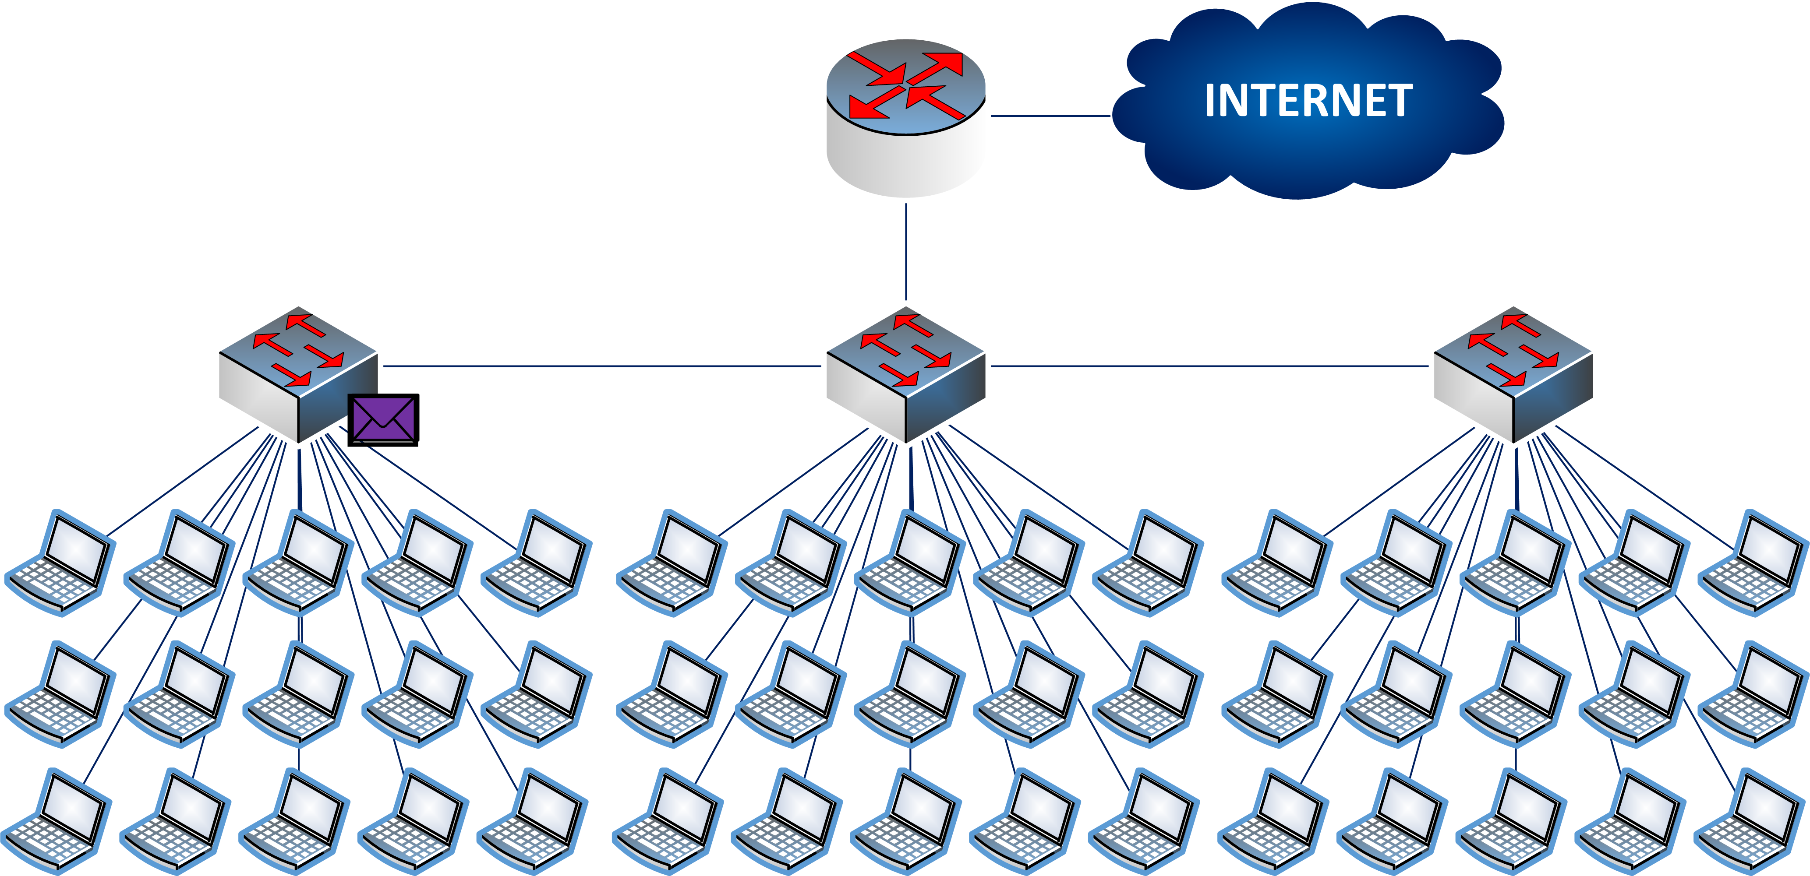
Broadcast

Slide 10
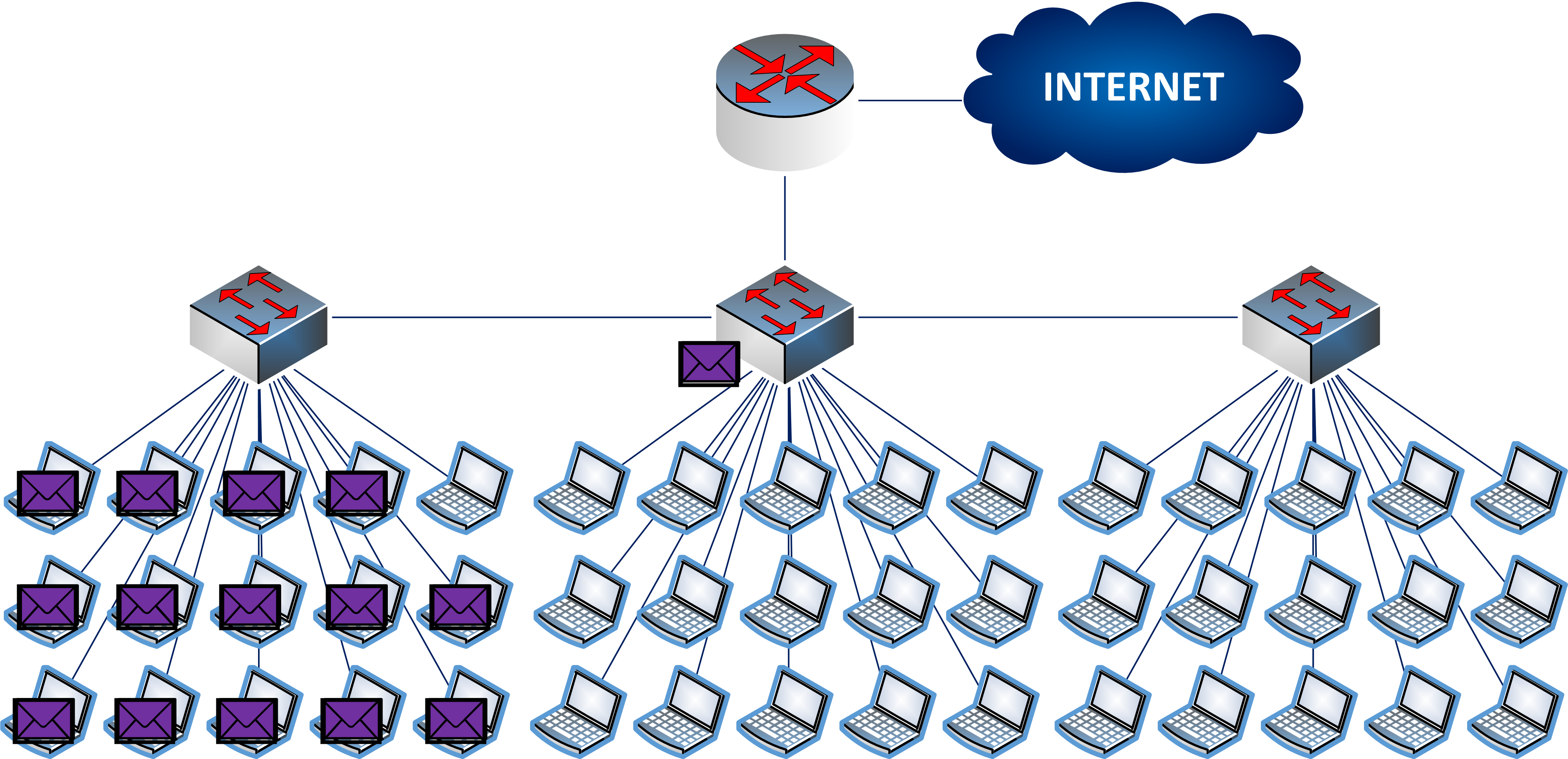
Broadcast

Slide 11
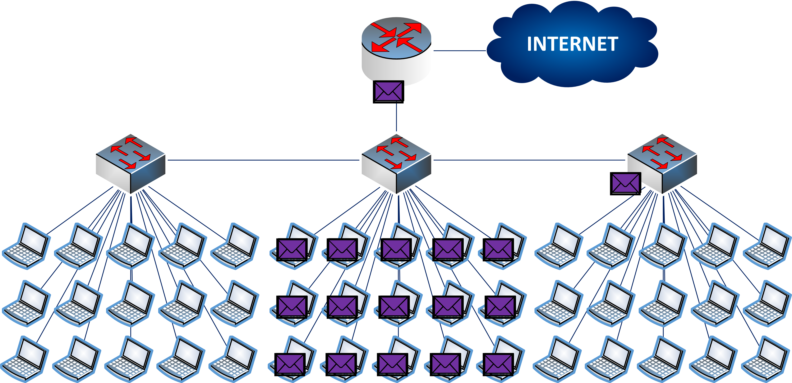
Broadcast

Slide 12
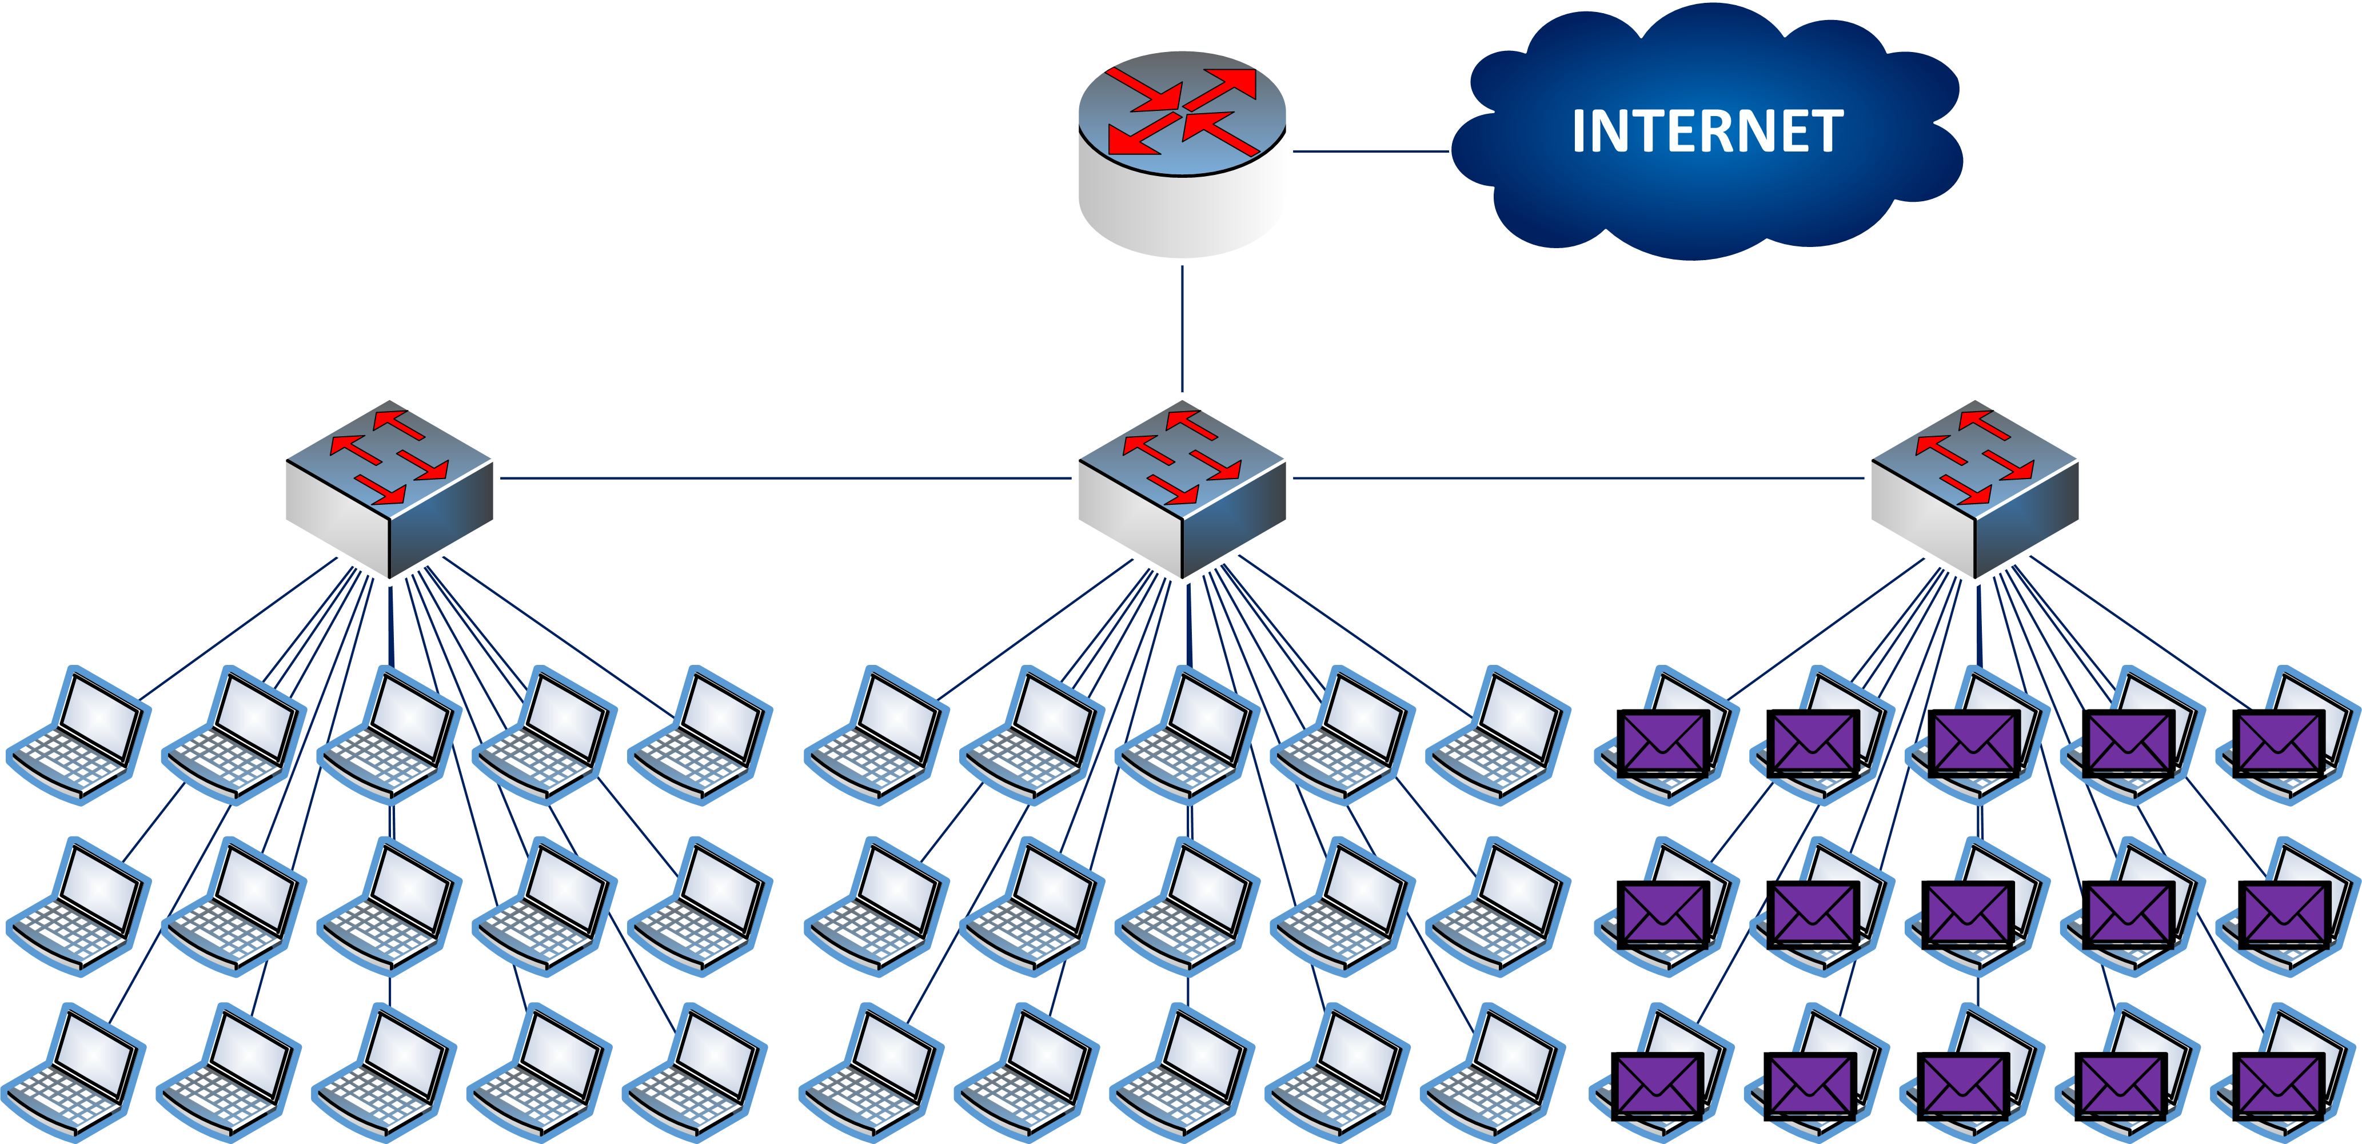
Broadcast

Slide 13
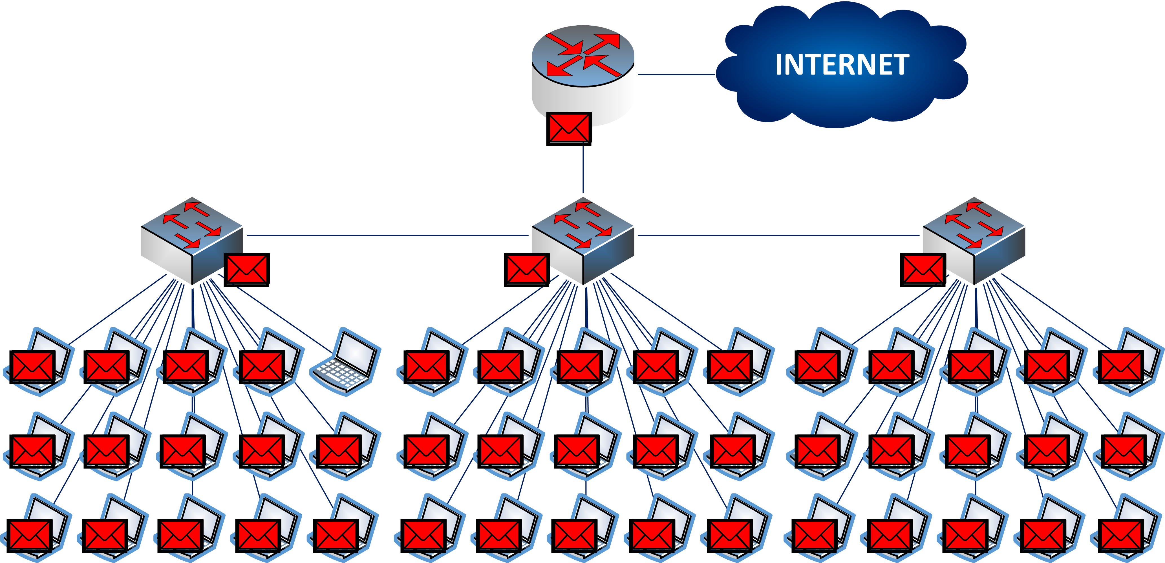
Security

Slide 14
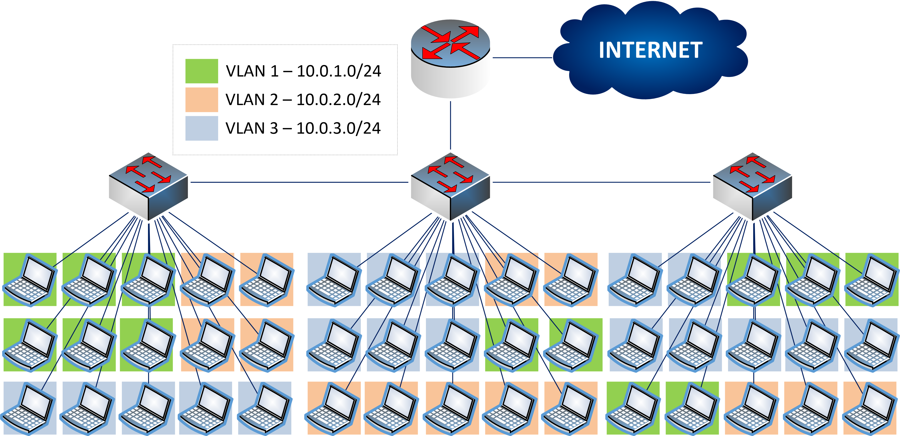
VLANs

Slide 15

VLANs

Slide 16
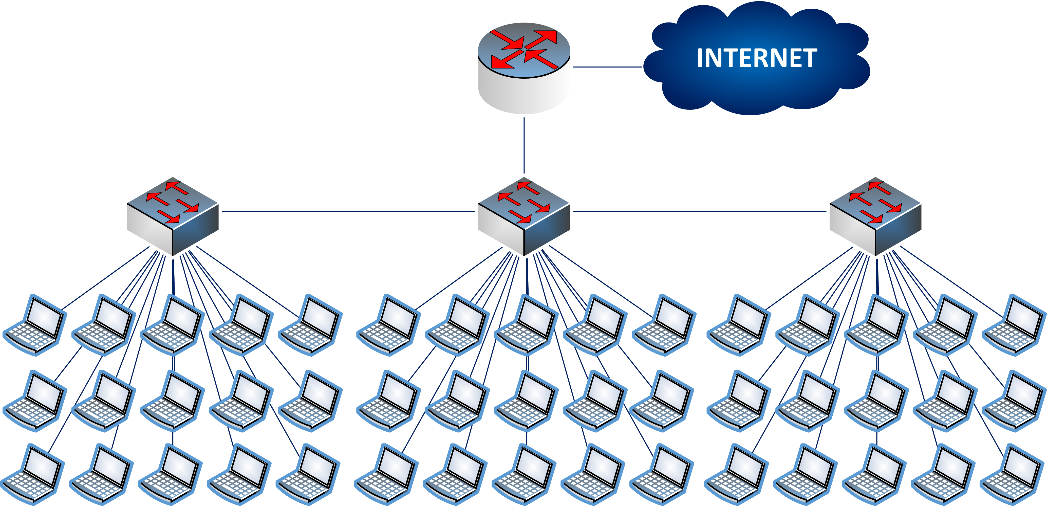
Smaller Segments

Slide 17

Smaller Segments

Slide 18

Smaller Segments

Slide 19
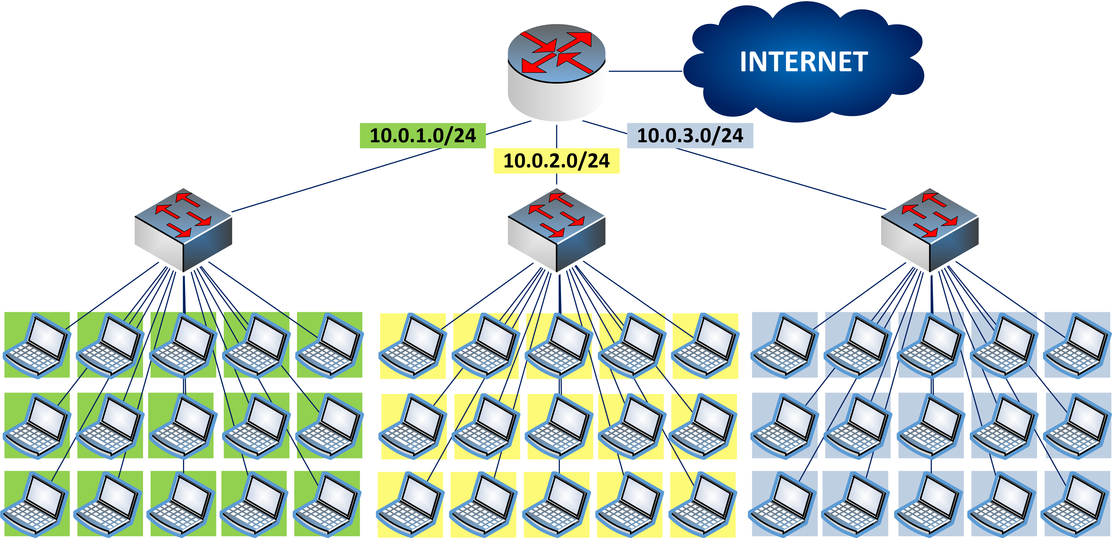
Smaller Segments

Slide 20
IP Subnetting – Zero to Hero Why do we need subnetting?
CyberQuince

Slide 21
Title
hhh

